Slide 1

Multi-Modal Explainable AI Framework for Osteoporosis Risk Scoring Using Knee X-ray Imaging and Clinical Data
MAJOR PROJECT - SECOND REVIEW
Guide : Dr. S. Muruganandam,
Assistant Professor (III),
Department of Data Science,
SASTRA Deemed University,
Chennai.
Name : M.Jeevitha
Roll No : 126150018
Branch : M.Sc Data Science - II
Code : INT500R01
Date : 17/04/2026
SASTRA Deemed University, Thanjavur.

Slide 2
PROBLEM STATEMENT
Osteoporosis and osteopenia are progressive bone disorders that often remain undiagnosed until a fracture occurs. In weight-bearing joints such as the knee, reduced bone mineral density significantly increases the risk of fractures, leading to pain, loss of mobility, and long-term disability.
Current diagnostic methods primarily rely on manual interpretation of knee X-ray images, which is time-consuming, subjective, and prone to inter-observer variability. Furthermore, early-stage changes in bone density are subtle and difficult to detect visually, resulting in missed or delayed diagnoses.
The lack of an efficient, accurate, and automated system for early detection of bone deterioration contributes to increased fracture risk, delayed clinical intervention, and a higher overall healthcare burden.

Slide 3
OBJECTIVES
Primary Objective
Patient Centric Multi-Modal Explainable AI Framework for Osteoporosis Risk Scoring Using Knee X-ray Imaging and Clinical Data
Specific Objectives
Perform Binary and Multiclass Classification using Knee X-ray images
Apply Transfer Learning to improve model performance
Analyze clinical (CSV) data to assess patient health factors and perform prediction
Develop a Machine Learning for clinical data-based prediction and risk scoring
Generate Bone Risk Score and Implement Explainable AI (Grad-CAM) for visual interpretation
Develop a multi-modal system that support early detection and clinical decision-making

Slide 4
BASE PAPER DETAILS
Field | Details
Paper Title | Deep‑learning based osteoporosis classification in knee X‑rays using transfer‑learning approach [4]
Authors | Muhammad Bilal Qureshi, Muhammad Sani, Ali Raza, Muhammad Shuaib Qureshi, Wajdi Alghamdi, Shahid Akbar, Rabiah Abdul Kadir & Mahidur R. Sarker.
Journal | Scientific Reports
Publisher | Springer Nature
Volume / Year | 2025
Date Published | 03 November 2025
DOI | 10.1038/s41598-025-24338-4
Impact Factor | ~4.6
Table 1: Base paper details

Slide 5
LITERATURE REVIEW
S. No | Title of Paper | Author(s) & Year | Models Used | Accuracy Achieved | Research Gap
1 | Intensive Statistical Exploration to Identify Osteoporosis Predisposing Factors and Optimizing Recognition Performance with Integrated GP Kernels. ^{[1]} | Ruhul Amin, 2023 | Statistical Analysis + Gaussian Process Kernels + ML Models | 86.64% | Focuses on clinical data, not X-ray images. Not suitable for automated screening. No image-based diagnosis.
2 | A Hybrid Attention-Driven Deep Learning Model for Osteoporosis Detection in Knees. ^{[2]} | Ishaq Muhammad & Bumshik Lee, 2024 | DenseNet169 + Custom Attention Model + CNN | 84.72% | Does not support multi-class classification (only binary). Requires high computational resources. Lacks explainability techniques such as Grad-CAM.
3 | Classification of Osteoporosis in Knee X-ray using Transfer Learning and Random Forest. ^{[3]} | Wesam A. Hidar, 2024 | ResNet50, ResNet101, VGG16, VGG19 + Random Forest | 78.39% | Moderate accuracy. No end-to-end deep learning. Limited explainability. No risk score generation.
4 | Deep-Learning Based Osteoporosis Detection Using Knee X-Ray Images (Scientific Reports). ^{[4]} | Qureshi, 2025 | ResNet-50 (Transfer Learning) + CNN | 90% | Only binary classification. No multi-class prediction. No explainable AI. Limited real-world testing.
5 | Osteoporosis diagnosis in knee X-rays by transfer learning based on convolution neural network. ^{[11]} | Qureshi, 2024 | AlexNet, VGG16, VGG19, DenseNet121, U-Net, ResNet | 90% | Small datasets. Lack of interpretability. No integrated risk scoring system.
Table 2 : Literature review

Slide 6
DATASET DESCRIPTION
Dataset name | Class | No.of Images | Link
Osteoporosis knee x-ray multiclasses dataset | Multiclass dataset | Normal -780 Osteoporosis -793 Osteopenia-374 | Kaggle
Osteoporosis Knee Dataset | Binary class dataset | Normal -186 Osteoporosis -186 | Kaggle
Osteoporosis | Binary class dataset | Normal -372 Osteoporosis -372 | Kaggle
Osteoporosis Knee X-ray Dataset | Binary class dataset | Normal -186 Osteoporosis -186 | Kaggle
Osteoporosis (CSV) | CSV Dataset(Binary) | Rows - 1959 Columns - 16 | Kaggle
Sample Clinical data:
Table 3 : Dataset description
Fig 1 : Sample data

Slide 7
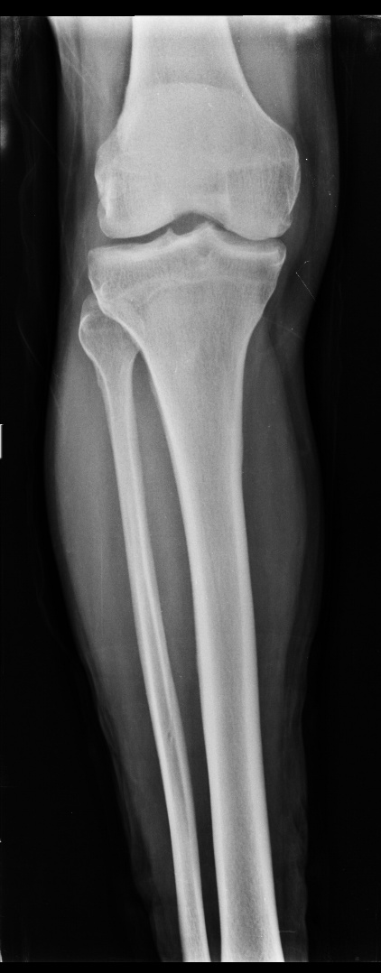
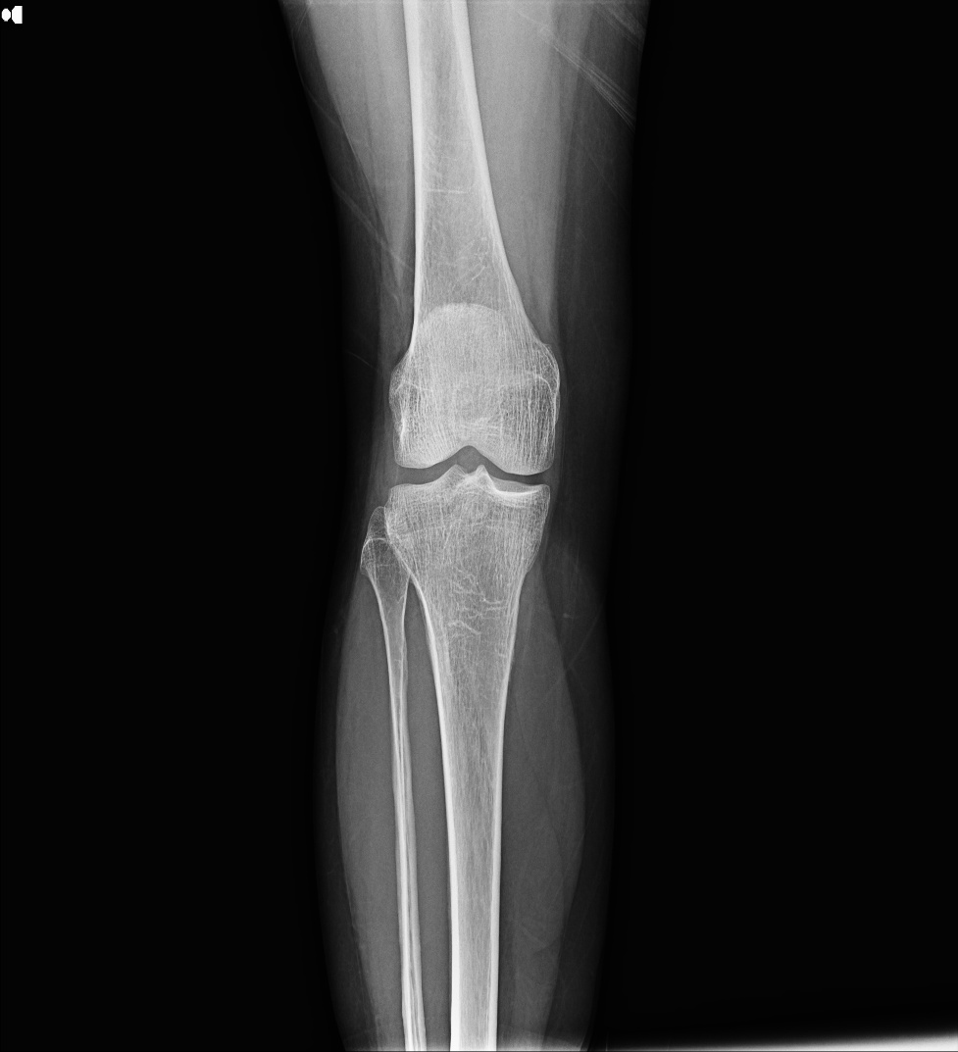
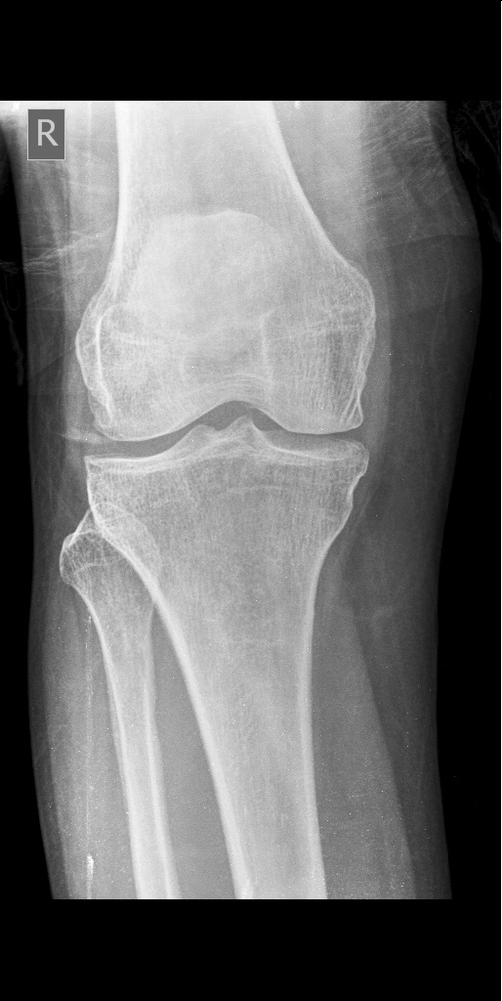
SAMPLE IMAGES
Normal
Osteopenia
Osteoporosis
Fig 2 : Normal
Fig 3: Osteopenia
Fig 4 : Osteoporosis

Slide 8
PROPOSED METHODOLOGY
Image data
Clinical data
Dataset collection 4 Kaggle datasets merged
Clinical CSV dataset 1959 rows, 16 features, from kaggle
Preprocessing & Augmentation Resize 224 x 224, normalize, augment
Feature Engineering Cleaning, Encoding
Stratified Split 70% train, 15% val, 15% test
Train/ Test split 80% train, 20% test
Binary class
Multiclass
Transfer learning models ResNet50, MobileNetV2, DenseNet121, EfficientNetB0
ML models training Logistic Regression, Decision Tree, Random Forest, GB
Model Evaluation & Selection Best: ResNet50 : 94%(Binary) , 83% (Multiclass)
Model Evaluation & Selection Best: Gradient Boosting – 91% accuracy
Grad-CAM explainability Highlights which region influence prediction
Clinical risk prediction probability – osteoporosis risk score
Image- based bone risk score Confidence probability: 0-100% risk
Clinical bone risk score Confidence probability: 0-100% risk
Multimodal integration & Web based deployment

Slide 9
STEPS:
Merged four knee X-ray datasets and applied preprocessing (resizing, normalization, augmentation)
Developed binary classification models using transfer learning (EfficientNet, ResNet50, MobileNetV2, DenseNet121) and performed model evaluation (Accuracy, Precision, Recall, F1-Score, ROC-AUC) to select the best model
Extended to multi-class classification (Normal, Osteopenia, Osteoporosis)
Processed clinical (CSV) data and developed a machine learning model
Generated personalized bone risk score for both clinical data and X-ray image data and applied Grad-CAM for explainable AI visualization
Integrated image and clinical models into a multi-modal system
Deployed as a web-based application.

Slide 10
RESULTS
Binary classification:
Model | Accuracy | Recall | Precision | F1-score | AUC
EfficientNetB0 | 0.90 | 0.94 | 0.87 | 0.91 | 0.97
ResNet50 | 0.94 | 0.97 | 0.92 | 0.94 | 0.99
MobileNetV2 | 0.93 | 0.94 | 0.93 | 0.94 | 0.98
DenseNet121 | 0.92 | 0.96 | 0.89 | 0.93 | 0.98
Table 4 : Result for binary class

Slide 11
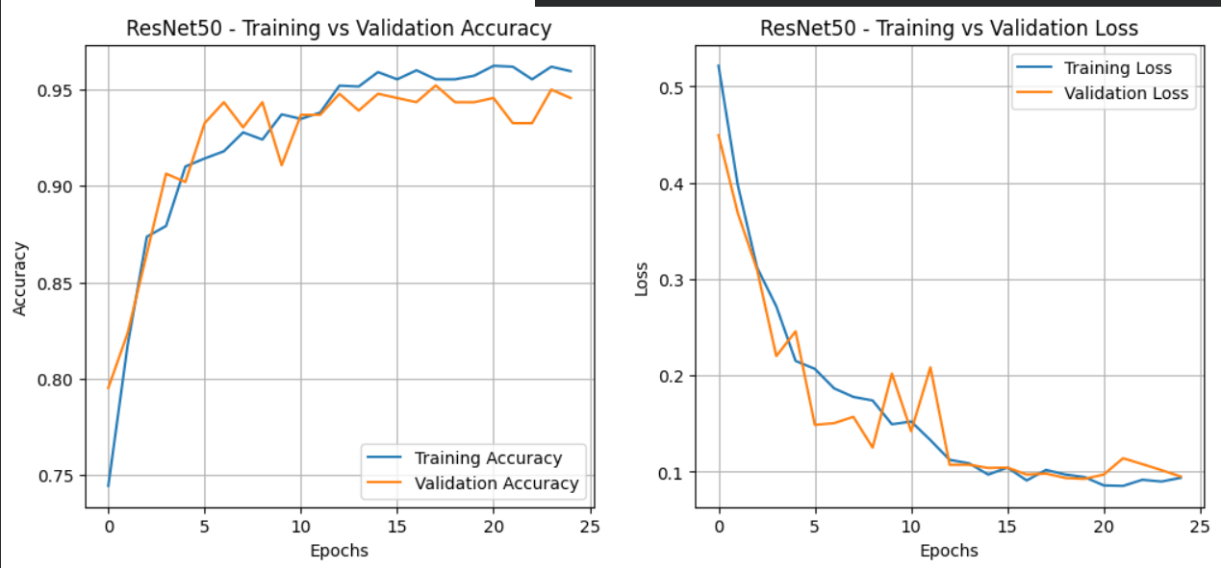
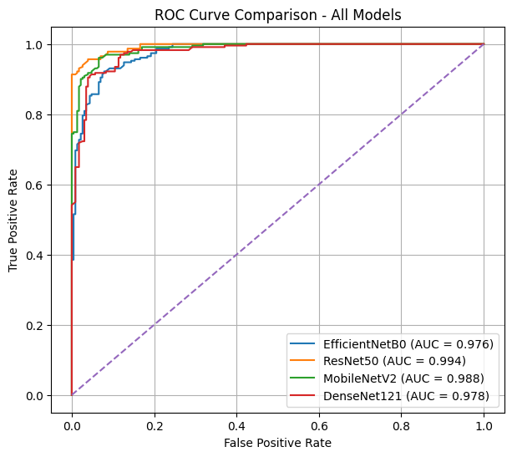
CURVES
Binary class :
Learning curve
ROC curve
Fig 5
Fig 6

Slide 12
RESULTS
Multi classification:
Model | Accuracy | Recall | Precision | F1-score | AUC
EfficientNetB0 | 0.82 | 0.88 | 0.75 | 0.81 | 0.95
ResNet50 | 0.83 | 0.80 | 0.85 | 0.82 | 0.95
MobileNetV2 | 0.81 | 0.80 | 0.83 | 0.81 | 0.94
DenseNet121 | 0.79 | 0.71 | 0.83 | 0.77 | 0.93
Table 5 : Results for multi class

Slide 13
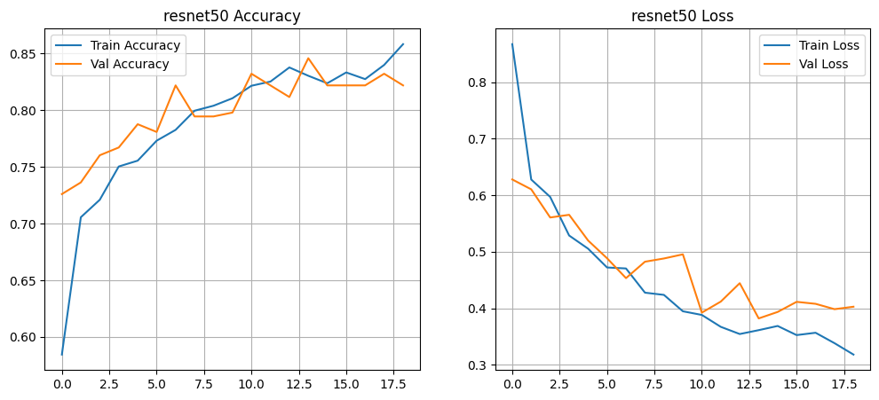
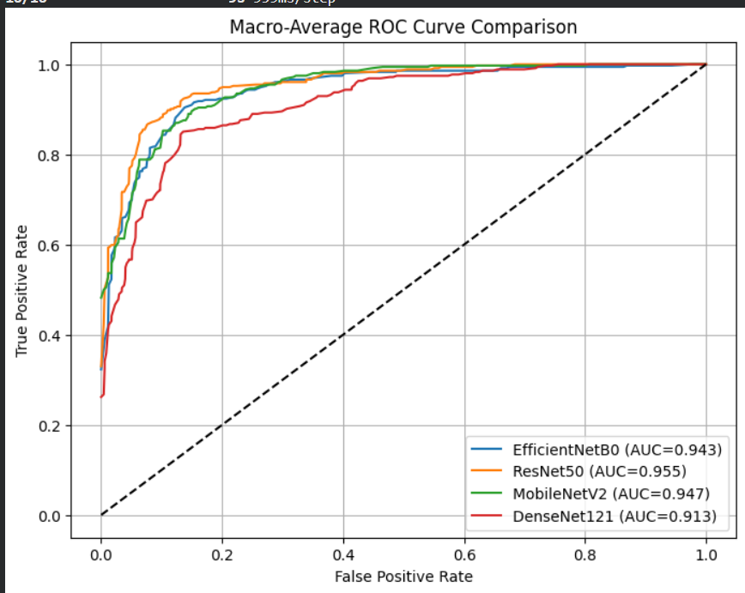
CURVES
Multi class :
Learning curve
ROC curve
Fig 7
Fig 8

Slide 14
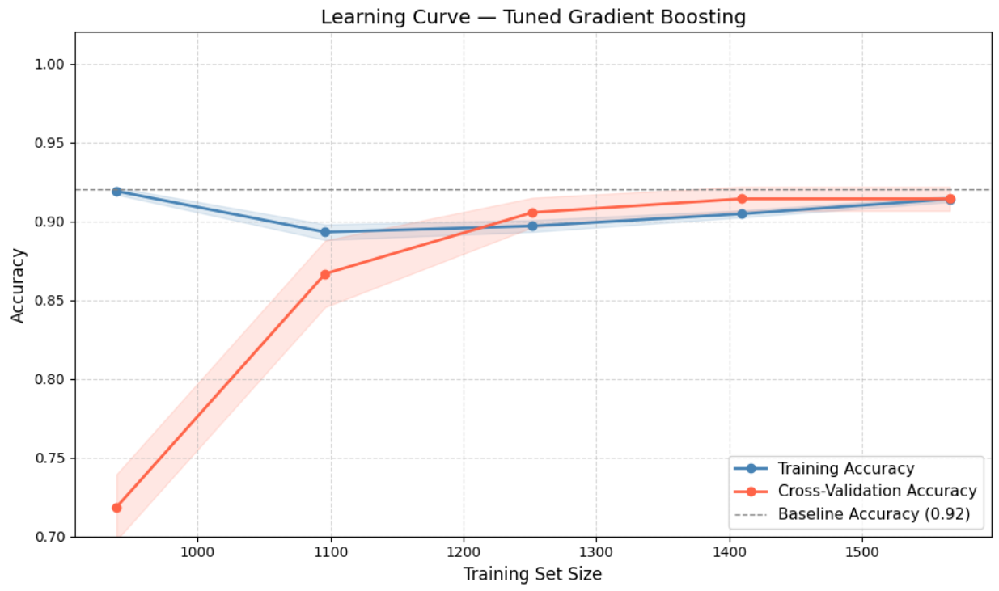
RESULTS
CSV dataset:
Model | Accuracy | Recall | Precision | F1-score
Logistic Regression | 0.84 | 0.77 | 0.89 | 0.83
Decision Tree | 0.84 | 0.85 | 0.83 | 0.84
Random Forest | 0.87 | 0.79 | 0.95 | 0.86
Gradient Boosting | 0.91 | 0.82 | 0.99 | 0.90
Learning curve
Table 6 : Results for clinical data fig 9 : Learning curve

Slide 15

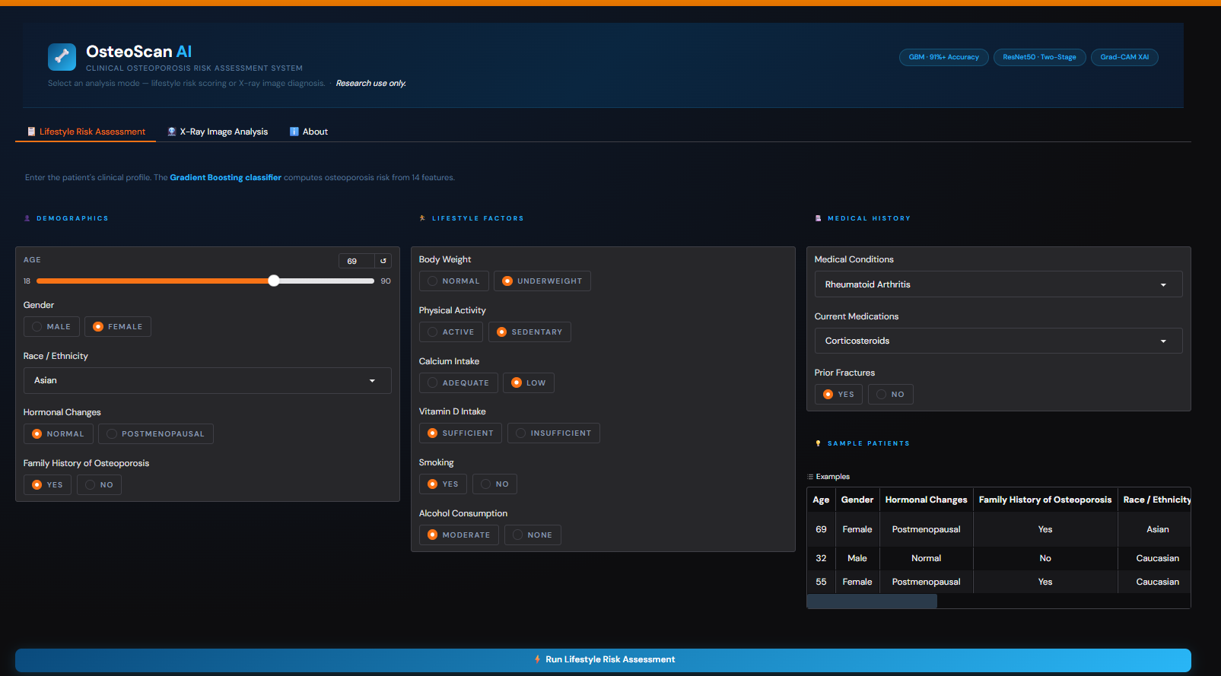
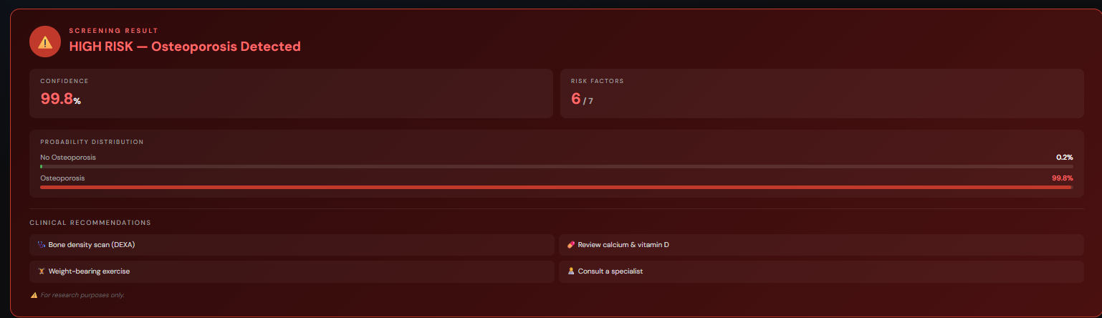
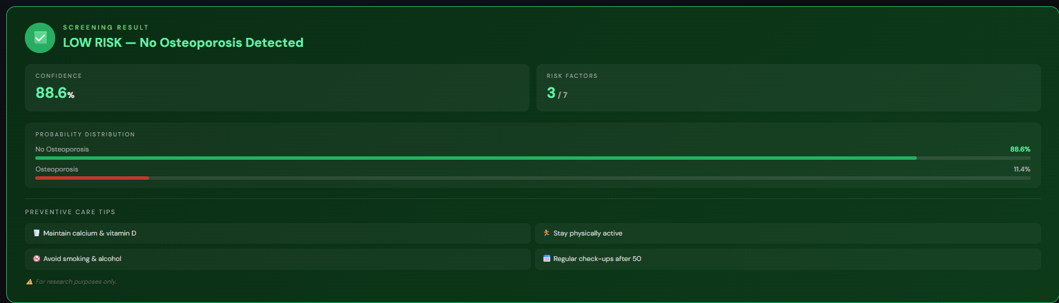
DEPLOYMENT (CLINICAL DATA)
fig 10 : Input : clinical data
fig 11 : Output prediction : Osteoporosis
fig 12 : Output prediction : Normal

Slide 16

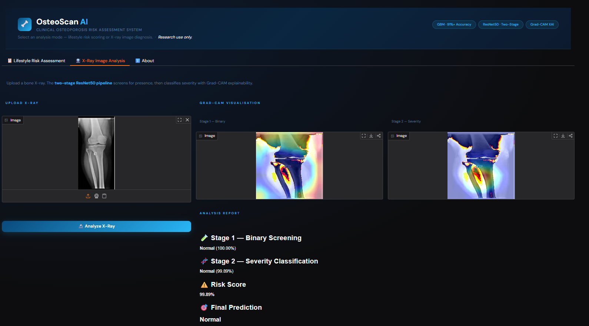
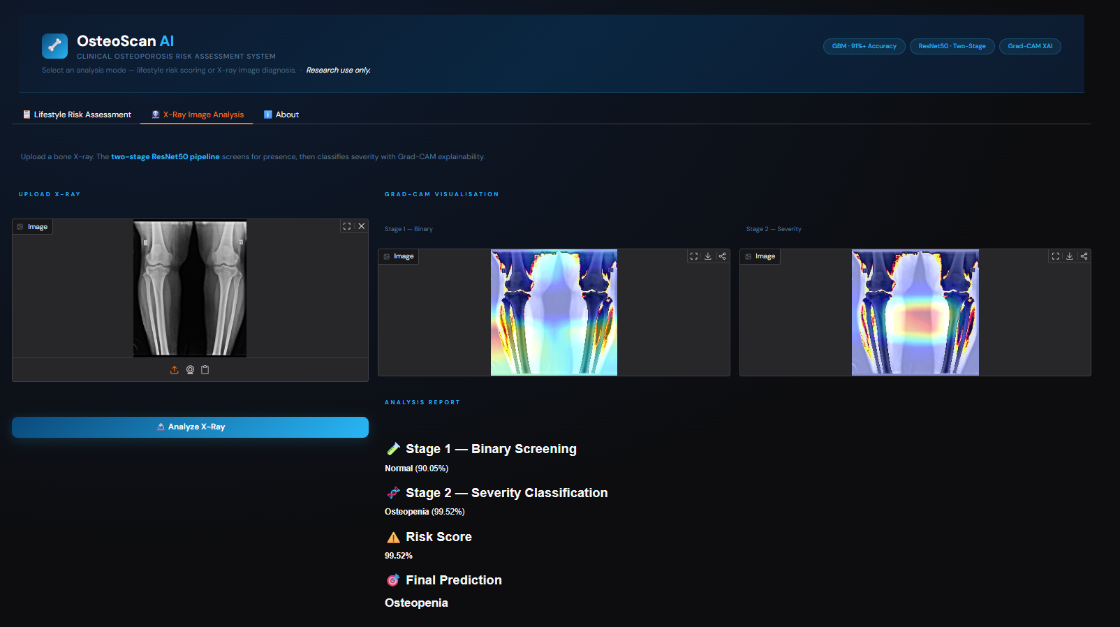
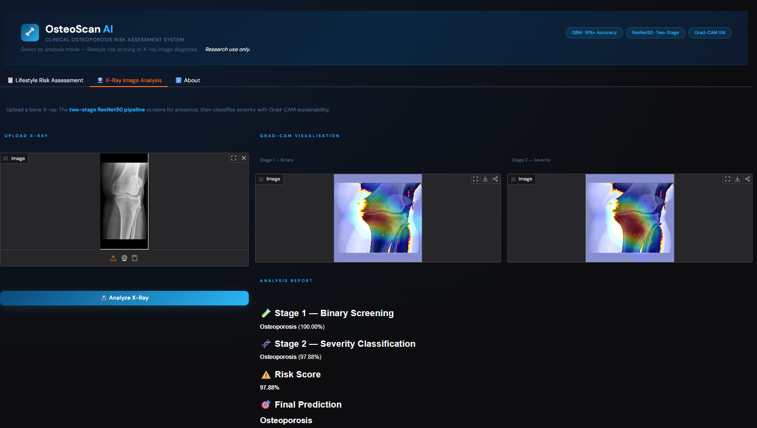
DEPLOYMENT (IMAGE DATA)
fig 13: Input : Image data
Ouput prediction :Normal
fig 14 : Output prediction : Osteoporosis
fig 15 : Output prediction : Osteopenia

Slide 17
CONCLUSION
Developed binary & multi-class models for knee osteoporosis detection
Achieved high accuracy (94% binary, 83% multiclass) using transfer learning
Built a clinical (CSV) model for prediction and bone risk scoring
Applied Grad-CAM for explainable AI insights
Integrated into a multi-modal system and deployed as a web application ( Deploy link)
Improve model accuracy using larger and more diverse datasets
Integrate real-time clinical validation and feedback from healthcare professionals
Extend deployment into a scalable real-world clinical decision support system
FUTURE WORK

Slide 18
REFERENCES
R. Amin, M. S. Reza, M. Maniruzzaman, M. A. M. Hasan, H.-S. Lee, S.-W. Jang, and J. Shin, “Intensive Statistical Exploration to Identify Osteoporosis Predisposing Factors and Optimizing Recognition Performance With Integrated GP Kernels,” IEEE Access, vol. 11, pp. 131339–131349, 2023. Available: https://doi.org/10.1109/ACCESS.2023.3336422
I. Muhammad and B. Lee, “A Hybrid Attention-Driven Deep Learning Model for Osteoporosis Detection in Knees,” IEEE Xplore, 2024. Available: https://ieeexplore.ieee.org
W. A. Hidar, A. J. Hyssian, A. S. Mubarak, H. M. Tawfik, L. R. David, and D. U. Ozsahin, “Classification of Osteoporosis in Knee X-ray using Transfer Learning and Random Forest,” Proc. IEEE Int. Conf. Data Engineering and Systems Engineering (DeSE), 2024. Available: https://ieeexplore.ieee.org/document/10912021
M. B. Qureshi et al., “Deep‑learning based osteoporosis classification in knee X‑rays using transfer‑learning approach,” Scientific Reports, vol. 15, 2025. Available: https://doi.org/10.1038/s41598-025-24338-4
M. B. Qureshi et al., “Recent Advances in Osteoporosis Detection Using Machine Learning and Deep Learning Models,” Scientific Reports, 2025. Available: https://www.nature.com/articles/s41598-025-24338-4

Slide 19
S. L. Mohanty, A. K. Pati, S. Saha, S. Gayen, A. Pati, and A. Panigrahi, “Enhanced Deep Learning for Multi-Class Osteoporosis Detection via Feature Fusion of Diverse Pre-Trained Models from Knee X-Ray Images,” Proc. Int. Conf. on Responsible, Generative and Explainable AI (ResGenXAI), IEEE, 2025. doi: 10.1109/RESGENXAI64788.2025.11344050.
K. S., J. A., L. Krishnasamy, D. S., P. S., and D. S. R., “Leveraging Advanced Deep Learning Architectures for Precise Knee Osteoporosis Prediction: A Paradigm Shift in Diagnostic Healthcare,” Proc. 2024 2nd Int. Conf. on Advances in Computation, Communication and Information Technology (ICAICCIT), IEEE, 2024. doi: 10.1109/ICAICCIT64383.2024.10912266.
L. Manas, C. K. Kumar, A. K. Venkatesh, and O. S. Powar, “Machine Learning Based Osteoporosis Detection,” Proc. 2025 Control Instrumentation System Conf. (CISCON), IEEE, 2025. doi: 10.1109/CISCON66933.2025.11337458.
R. Sultana, M. Zaman, N. Ivković, K. Cengiz, I. Rafaqat, and A. Akhunzada, “Efficient Detection of Knee Osteoporosis Using the Swin Transformer on X-Ray Images,” Proc. 2024 Int. Conf. on Computer and Applications (ICCA), IEEE, 2024. doi: 10.1109/ICCA62237.2024.10928051.
A. M. Sarhan et al., “Knee Osteoporosis Diagnosis Based on Deep Learning,” International Journal of Computational Intelligence Systems, vol. 17, no. 241, 2024. doi: 10.1007/s44196-024-00615-4.
M. Wani and S. Arora, “Osteoporosis diagnosis in knee X-rays by transfer learning based on convolution neural network,” Multimedia Tools and Applications, vol. 82, pp. 14193–14217, 2023. doi: 10.1007/s11042-022-13911-y.

Slide 20


